Slide 1

Business Data Analysis
Updated on 2012-2-1

Slide 2
business data analysis
technologies & samples
most downloaded technologies & analysis
most downloaded samples & analysis
sample quality
sample rating analysis
cpe
survey data analysis
customer reach
top referral sites & analysis
download# by region & analysis
jump to conclusion

Slide 3
technologies
most downloaded technologies
technologies with the highest avg. monthly download# / sample
data source: MSDN Samples Gallery Statistics Reporting Server
Technology | Sample# | Avg Monthly Downloads / Sample
Windows Phone | 1 | 1029.06
SharePoint | 1 | 594.27
SQL Azure | 1 | 527.53
ASP.NET | 121 | 499.94
WCF | 12 | 479.79
Windows Azure | 34 | 478.63
Data Platform | 42 | 449.28
Silverlight | 65 | 414.74
Network | 23 | 407.07
WPF | 30 | 393.32
Windows Forms | 43 | 392.17
Programming Language | 6 | 382.21
IE | 30 | 377.04
Windows SDK | 194 | 336.74
Dynamics | 3 | 329.18
WF | 17 | 322.90
Windows 7 | 23 | 316.95
VSX | 26 | 308.55
Office | 43 | 303.16
TFS | 7 | 283.70
Windows UI | 5 | 278.13
Fusion and Interop | 21 | 276.16
WDK | 7 | 269.37
XML | 12 | 262.16
IIS | 5 | 250.69
Diagnostics | 5 | 209.39
Notes:
Add survey# - month chart.

Slide 4
samples
most downloaded samples
samples with the highest monthly download# in each technology
data source: MSDN Samples Gallery Statistics Reporting Server
Technology | Sample | Monthly Downloads
Windows Phone | CSWP7AzureVideoStory | 1300.59
SharePoint | CSSharePointSilverlightIntegration | 594.27
SQL Azure | CSSqlAzurePartitioning | 527.53
ASP.NET | CSASPNETAJAXWebChat | 1835.31
 | CSASPNETGridView | 1382.87
 | CSASPNETImageEditUpload | 1088.94
WCF | CSAzureWCFServices | 785.18
 | CSSL4WCFNetTcp | 698.25
 | CSAzureTableStorageWCFDS | 667.43
Windows Azure | CSWP7AzureVideoStory | 1300.59
 | CSAzureBingMaps | 1226.73
 | CSAzureChangeAppPoolIdentity | 802.11
Data Platform | VBUseADONET | 825.56
 | CSUseADONET | 801.98
 | CSADONETDataServiceSL3Client | 704.36
Silverlight | CSSL4MusicPlayer | 1509.90
 | CSSL4UdpAnySourceMulticast | 952.77
Network | CSSL4UdpAnySourceMulticast | 952.77
 | CSFTPUpload | 544.37
WPF | CSWPFSearchAndHighlightText | 960.86
Windows Forms | CSWinFormDataGridView | 1068.27
Programming Lang | CSDynamicallyBuildLambdaExp | 696.34
IE | CSIEExplorerBar | 561.06
Windows SDK | CSSoftKeyboard | 788.25
Dynamics | CSDynamicsPowerShellAdmin | 531.30
WF | CSAzureWorkflowService4 | 482.16
Windows 7 | CSWin7Direct2D | 425.82
VSX | CSVSXProjectSubType | 520.17
Office | CSASPNETExcelImportExport | 1007.39
TFS | CSTFSEventListener | 369.80
Windows UI | CppWindowsCommonControls | 522.69
Fusion and Interop | CppCLINativeDllWrapper | 486.68
WDK | CppStorageEnum | 649.14
XML | CSLinqToXml | 340.77
IIS | CSIIS7AdminMWA | 339.34
Diagnostics | CppResourceLeaks | 221.97
Notes:
Add survey# - month chart.

Slide 5
analysis
Most Downloaded Technologies are Windows Phone, SharePoint, SQL Azure, ASP.NET, WCF, Windows Azure, and Data Platform. Most of them are new web technologies.
Top 3 most downloaded technologies Windows Phone, SharePoint and SQL Azure have only one sample in the collection. The OneCode team may consider creating more samples for these technologies.
Most Downloaded Samples have these common features:
The demoed scenarios have large customer needs. (e.g. CSASPNETAJAXWebChat, CSSL4MusicPlayer, CSASPNETGridView, CSWinFormDataGridView, CSASPNETImageEditUpload, CSASPNETExcelImportExport)
Architectural sample applications that demo how to combine several hot technologies together. (e.g. CSWP7AzureVideoStory, CSAzureBingMaps)

Slide 6
sample quality
customer rating (1~5) of OneCode samples in MSDN Samples Gallery.
data source: MSDN Samples Gallery Read API
average rating of OneCode samples: 3.87
total rated samples / total samples: 216 / 721
sample# with >=4 rating (great samples): 139 (64% of rated samples)
sample# with <= 2 rating (poor samples): 27 (12.5% of rated samples)
total raters: 481
Today, sample rating is not in OneCode’s success metrics. We should set a goal of sample rating (sample quality) and track it in OneCode scorecard.

Slide 7

customer survey
understanding customers
value to customers
customer effort
satisfaction
customer comments
How do you think about OneCode?
take the survey>>>

Slide 8
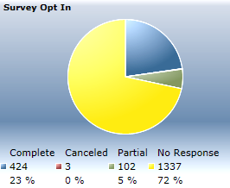
survey
purposes: understand target users and what OneCode can improve
platform: http://support.microsoft.com/common/survey.aspx?scid=sw;en;1759
survey data available at http://fmsanalytics/
survey audience: global OneCode users
date range: 2010-8 to 2012-1
volume: 424 completed surveys (FY11: 311; FY12 YTD: 113)
jump to survey summary
Notes:
Add survey# - month chart.

Slide 9
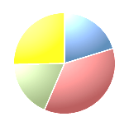
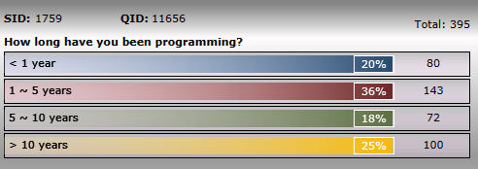
understanding customers
Main OneCode users are
sophomore developers (1~5 years)
senior developers (> 10 years)
OneCode is not a “hello world” code sample library for fresh developers (< 1 year)
Q1. How long have you been programming?
Q2. What areas of technology do you propose to have more code samples?

Slide 10
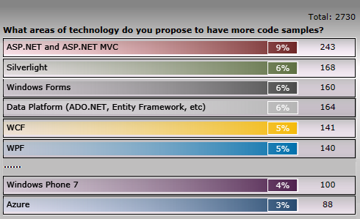
understanding customers
Top 5 techs that need samples are: (also influenced by the developer population of each tech)
ASP.NET and ASP.NET MVC (9%)
Silverlight (6%)
Windows Forms (6%)
Data Platform (ADO.NET, EF, etc) (6%)
Hot new techs e.g. Windows Phone (4%), Window Azure (3%) – are not among the top.
Q1. How long have you been programming?
Q2. What areas of technology do you propose to have more code samples?

Slide 11
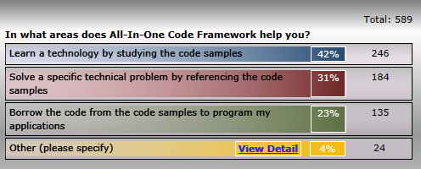
value to customers
54% reuse OneCode sample code to solve a problem or speed up programing their app.
42% learn a tech by studying OneCode samples
These are the two key values of OneCode samples
Q3. In what areas does All-In-One Code Framework help you?
Q4. Will you try to use the samples in the project in your future development?

Slide 12
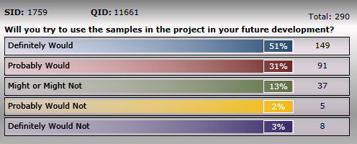
value to customers
Overall, 82% developers would try to reuse the OneCode samples in their future development of projects.
In FY12, 88% developers would try to reuse the OneCode samples. The percentage increases by 8% vs. FY11.
Q3. In what areas does All-In-One Code Framework help you?
Q4. Will you try to use the samples in the project in your future development?

Slide 13
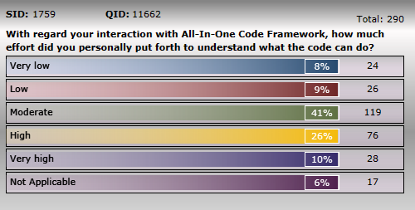
customer effort
Moderate ~ high effort is needed to understand OneCode code samples.
Q5. With regard your interaction with OneCode, how much effort did you personally put forth to understand what the code can do?
Q6. With regard your interaction with OneCode, how much effort did you personally put forth to apply the code sample in the support of meeting your needs?

Slide 14
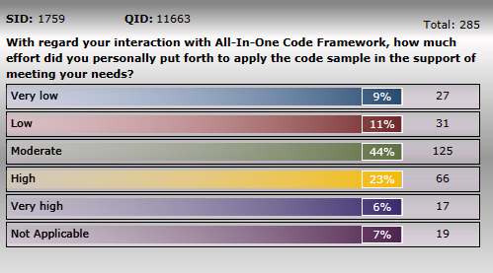
customer effort
Moderate ~ high effort is needed to apply the OneCode code sample in the support of customers’ needs.
Based on UX research of code examples, code samples have the disadvantages of “need time to reuse” in nature.
Q5. With regard your interaction with OneCode, how much effort did you personally put forth to understand what the code can do?
Q6. With regard your interaction with OneCode, how much effort did you personally put forth to apply the code sample in the support of meeting your needs?

Slide 15
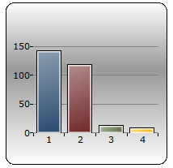
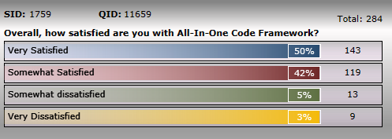
satisfaction
Half customers are very satisfied with OneCode.
92% of customers are (very or somewhat) satisfied with OneCode.
Q7. Overall, how satisfied are you with All-In-One Code Framework?

Slide 16
customer comments
Totally 34 valid comments in FY11 and 7 valid comments in FY12 YTD
Containing 8 positive feedback
FY12
I think that this Code Framework offers lots help for new hands in both programming and testing ! So glad that MS provides such experience to share with more Dev. Absolutely, many people will collect quite a lot Prototypes in their own Code-Library. That a global cooperation which will undoubtedly improve Software-development!
FY11
Continue with the very good work.
Just keep up the good work
It will obviously be handy. It was a great idea too. Great job so far.
Containing 39 improvement suggestions
more samples
Notes:
FY12 comments:
"I think that this Code Framework offers lots help for new hands in both programming and testing ! So glad that MS provides such experience to share with more Dev. Absolutely, many people will collect quite a lot Prototypes in their own Code-Library. That a global cooperation which will undoubtedly improve Software-development!"
Less description of COM controls given with vs2010
More samples
more samples on leveraging Windows Live
MORE DONUTS!
Very Dissatisfied as Dynamics is not included. There is a great opportunity for it.
Better categorization
Categorization should be better
my computer can't open some application, he need .NET Framework

Slide 17

customer comments What can we do to improve OneCode?
more samples (suggested in 17 comments, 43.6%)
Very Dissatisfied as Dynamics is not included. There is a great opportunity for it.
Get as much code samples out there as possible. Increase the amount of code that is written specifically for VS2010 and for SharePoint 2010.
More samples on leveraging Windows Live
More samples from your MVPs
Port more to the VS2010 collection. Keep the native C++ samples coming.
The more sample code the better framework is!

Slide 18



customer comments other improvement suggestions
morten
elvis
einstein
You might consider including a testing harness and/or test cases built in to the examples to promote consistent and thorough testing (of course using MS tools). ---> add unit test to released sample | Take on user sample requests while applying best practices. Nothing worse than "don't use in production as demo code only" as you see enough to start thinking that way and therefore putting it into production until the next code review. Having a demo version and a best practices would definitely make one read and work harder at understanding it. | Some videos could be added

Slide 19
survey summary
Most users are sophomore (1~5 years) and senior (>10 years) developers.
Top 5 technologies with sample demands are
ASP.NET /(MVC), Silverlight, Windows Forms, Data Platform
Code reuse and technology learning are how customers use OneCode
Moderate to high effort is needed to understand and reuse OneCode samples
92% of customers are satisfied with OneCode
Customers want more samples from OneCode (mentioned SharePoint, Dynamics, Windows Live, C++ samples)
Other proposals:
add unit test to released sample;
take on user sample requests while applying best practices;
create sample video;

Slide 20
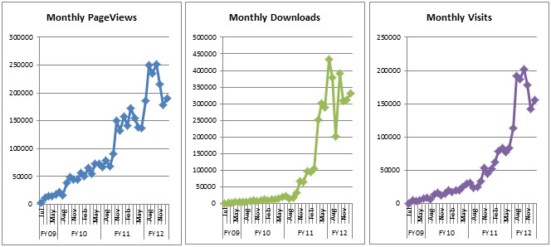
customer reach
Note:
In FY11 H2, OneCode sample downloads move from CodePlex to MSDN Samples Gallery, but the OneCode portal is still in CodePlex. Therefore, before FY11 H2, customer reach of OneCode = downloads in CodePlex; from FY11 H2, customer reach of OneCode =
downloads in CodePlex +
downloads in Gallery
 | Month | Download# | Page View# | Visit#
All | Total | 3,850,132 | 3,644,417 | 2,040,443
FY12 YTD | Total | 2,361,134 | 1,508,842 | 1,167,883
FY11 | Total | 1,357,340 | 1,486,699 | 648,392
FY10 | Total | 117,574 | 588,799 | 202,682
FY09 | Total | 14,084 | 60,077 | 21,486

Slide 21
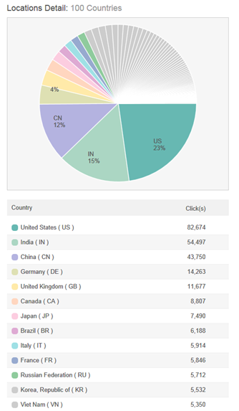
OneCode in MSDN Samples Gallery
containing all sample downloads since FY11 H2; it’s about 88.7% of total customer reach in FY12.
Top 10 referring sites in the past 6 months
http://1code.codeplex.com/wikipage?title=All-In-One%20Code%20Framework%20Sample%20Catalog
http://1code.codeplex.com/wikipage?title=All-In-One%20Code%20Framework%20Sample%20Catalog&referringTitle=Home
http://blogs.msdn.com/b/codefx/archive/2011/11/02/microsoft-all-in-one-code-framework-november-sample-updates.aspx
http://1code.codeplex.com/wikipage?title=All-In-One%20Code%20Framework%20Sample%20Catalog&referringTitle=Documentation
http://blogs.msdn.com/b/codefx/archive/2011/08/09/microsoft-all-in-one-code-framework-august-code-sample-updates.aspx
http://blogs.msdn.com/b/codefx/archive/2011/09/19/targeting-top-sample-quality-all-in-one-code-framework-is-on-its-way.aspx
http://blogs.msdn.com/b/codefx/archive/2011/12/29/microsoft-all-in-one-code-framework-december-sample-updates.aspx
http://blogs.msdn.com/b/codefx/archive/2011/10/03/microsoft-all-in-one-code-framework-sample-browser-v4-released-a-new-way-to-enjoy-700-microsoft-code-samples.aspx
http://blogs.msdn.com/b/codefx/archive/2011/07/13/new-code-sample-release-from-microsoft-all-in-one-code-framework-in-july.aspx
http://blog.miniasp.com/post/2011/07/12/Useful-Visual-Studio-2010-tool-All-In-One-Code-Framework-Sample-Browser.aspx

Slide 22
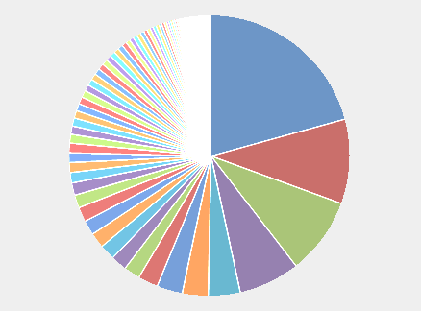
OneCode in CodePlex
containing the project portal, the download of sample browser, and sample downloads before FY12 H2; it’s about 11.3% of total customer reach in FY12.
Top 10 referring sites in the past 6 months
Location details
http://blogs.msdn.com/
http://visualstudiogallery.msdn.microsoft.com/b3aaa8f6-1b72-4ce2-bb39-f597489d55da
http://visualstudiogallery.msdn.microsoft.com/b3aaa8f6-1b72-4ce2-bb39-f597489d55da/description
http://blogs.msdn.com/b/codefx/archive/2011/10/03/microsoft-all-in-one-code-framework-sample-browser-v4-released-a-new-way-to-enjoy-700-microsoft-code-samples.aspx
http://msdn.microsoft.com/en-us/vstudio/dd238515
http://msdn.microsoft.com/library/windows/desktop/ff972463
http://visualstudiogallery.msdn.microsoft.com/4934b087-e6cc-44dd-b992-a71f00a2a6df/description
http://blogs.msdn.com/b/codefx/archive/2011/08/09/microsoft-all-in-one-code-framework-august-code-sample-updates.aspx
http://msdn.microsoft.com/en-us/dd238515.aspx
http://blogs.msdn.com/b/codefx/archive/2011/11/02/microsoft-all-in-one-code-framework-november-sample-updates.aspx
US
20.7%
IN
9.85%
CN
8.96%
United States | 20.7%
India | 9.85%
China | 8.96%
Germany | 7.10%
United Kingdom | 3.69%
Canada | 2.97%
South Africa | 2.95%
Russian Federation | 2.28%
France | 1.87%
Italy | 1.81%
Taiwan | 1.77%
Brazil | 1.73%
Australia | 1.67%
Korea, Republic of | 1.66%
Turkey | 1.48%
Japan | 1.40%
Poland | 1.19%

Slide 23
analysis
The customer reach of OneCode continues growing overally, but there’s a decline of downloads in FY12 because we moved our focuses from marketing to sample sweeping and sample quality improvements.
U.S., India and China are the top three countries visiting OneCode.
Among top 15 visiting countries, China, Russia, South Korea, Japan are non-native-English speaking countries, and OneCode may consider localizing samples to these languages.
Since we moved from CodePlex to MSDN Samples Gallery, the majority of downloads (88.7%) is from the gallery now.
MSDN blogs and Visual Studio Gallery are the top referring sites of OneCode.

Slide 24
conclusion
We should generate more samples for Windows Phone (if aligning with PG’s direction), SharePoint, SQL Azure, Windows Azure and Data Platform because
They are most downloaded technologies
We have only a few OneCode samples for these technologies
Customers are asking for SPS samples in survey comments.
Besides the typical OneCode samples for customers’ frequently asked programming scenarios, we may add more architectural sample applications to demonstrate how to combine multiple technologies together.
We should set a goal of sample quality (sample rating), and add it to OneCode success metrics. The current avg. rating is 3.87.
After the sample quality improvement effort in FY12, we should start to invest on marketing and promoting OneCode again and stimulate the customer reach.
Besides our current localization to Chinese, we may consider localizing OneCode samples to Russia, Korea and Japanese too.

